Slide 1
NOAA-21 Post-Launch Products Calibration Validation
Lihang Zhou (NOAA/NESDIS/LEO Ground Services)
Contributions from S. Kalluri, L. Dunlap, X. Liu, M. Divakarla, A. Young, I. Guch, S. Qiu, H. Kilcoyne, M. Ripley, W. Wolf, K. Shontz, M. Goldberg, Data Products and Management Services (DPMS), JPSS STAR Science Team Members, are thankfully acknowledged
March 3rd, 2021

Slide 2
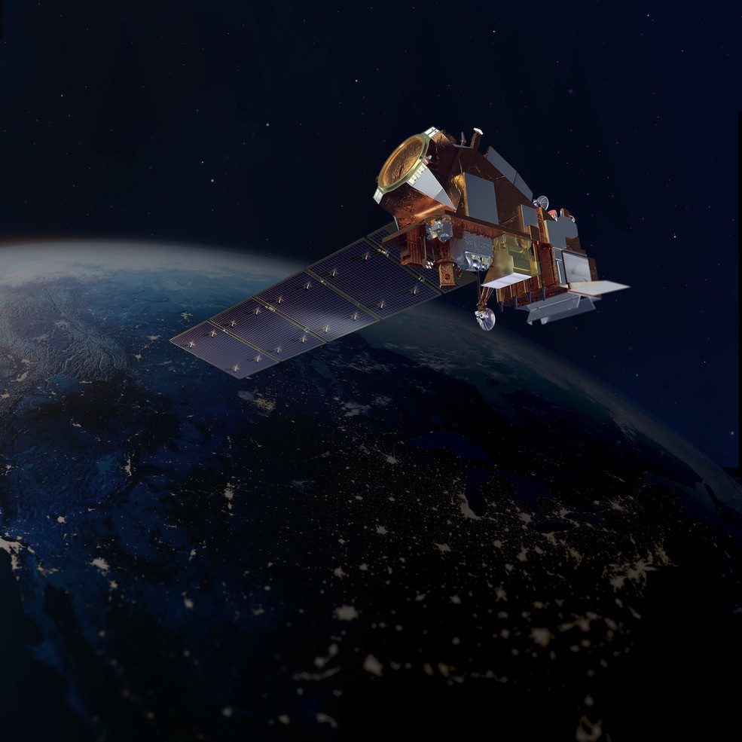
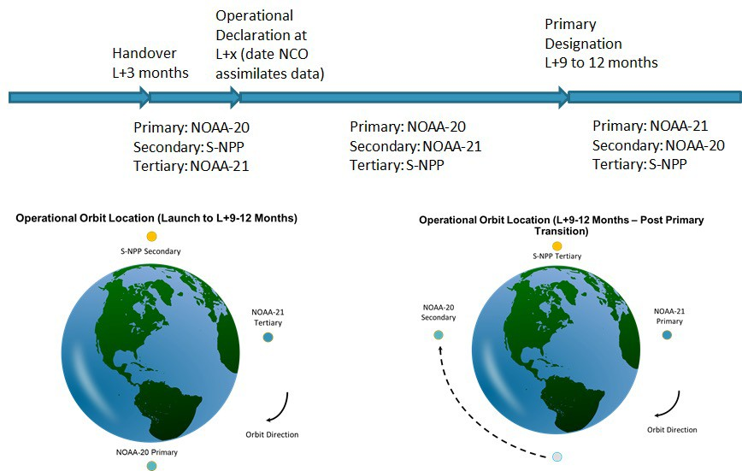
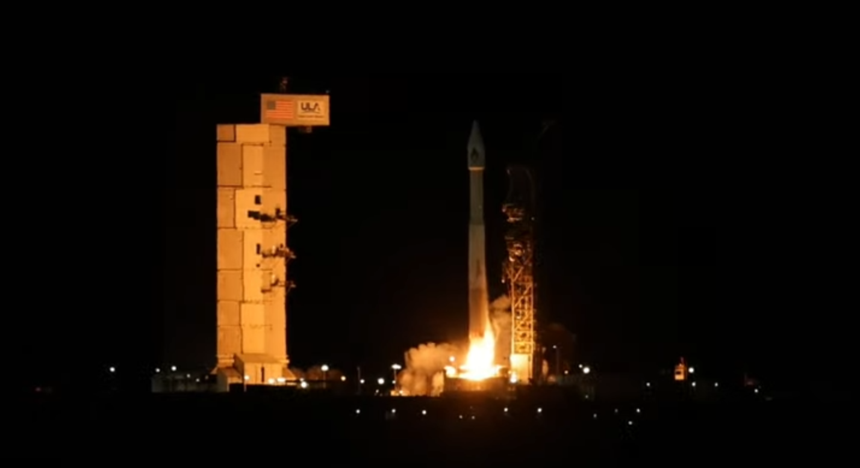
NOAA-21 Launch and Transition to Operations
Primary Satellite Designation Requirements:
JPSS-2 Launch: November 10, 2022
@ 0149 PST from Vandenberg AFB
Key performance parameters (KPP) req. are met
Prime instruments reached at least provisional maturity and were declared operational (data accepted by key stakeholders)
NWS and mission partners agreed they were ready to transition

Slide 3
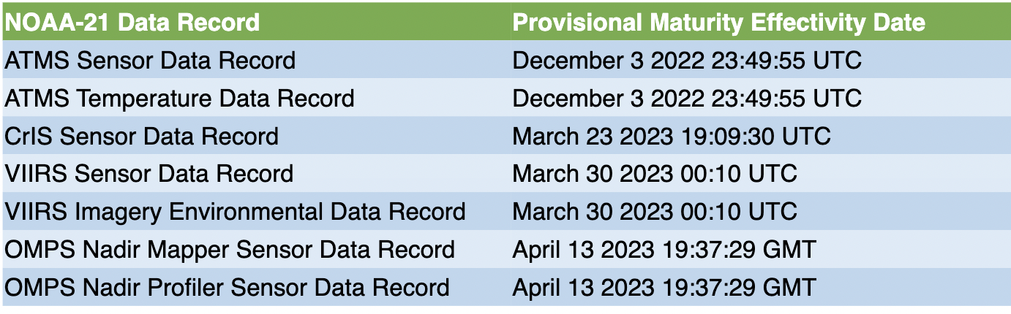
JPSS Algorithms & Cal Val Updates
All NOAA-21 Mission Unique Products (ATMS, CrIS, VIIRS, and OMPS SDRs and Imagery EDRs) reached Provisional Maturity, on schedule; in some cases ahead of schedule by over three weeks early.
MIRS, Snowfall Rate, SST, and Ozone EDRs reached Beta Maturity

Slide 4
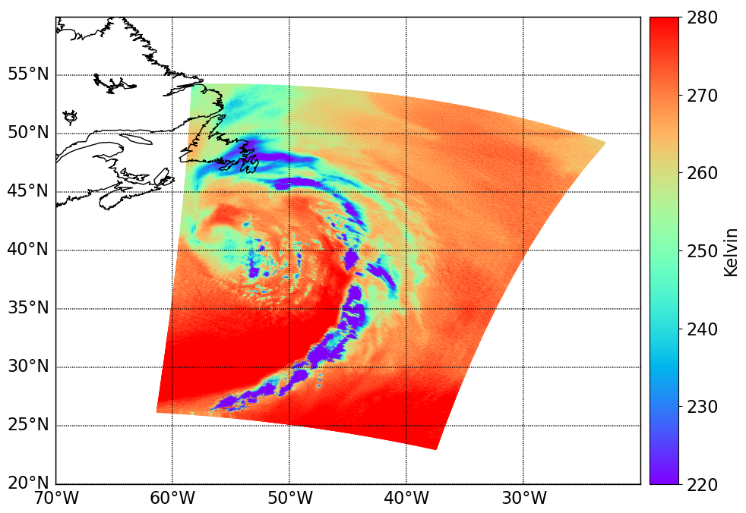
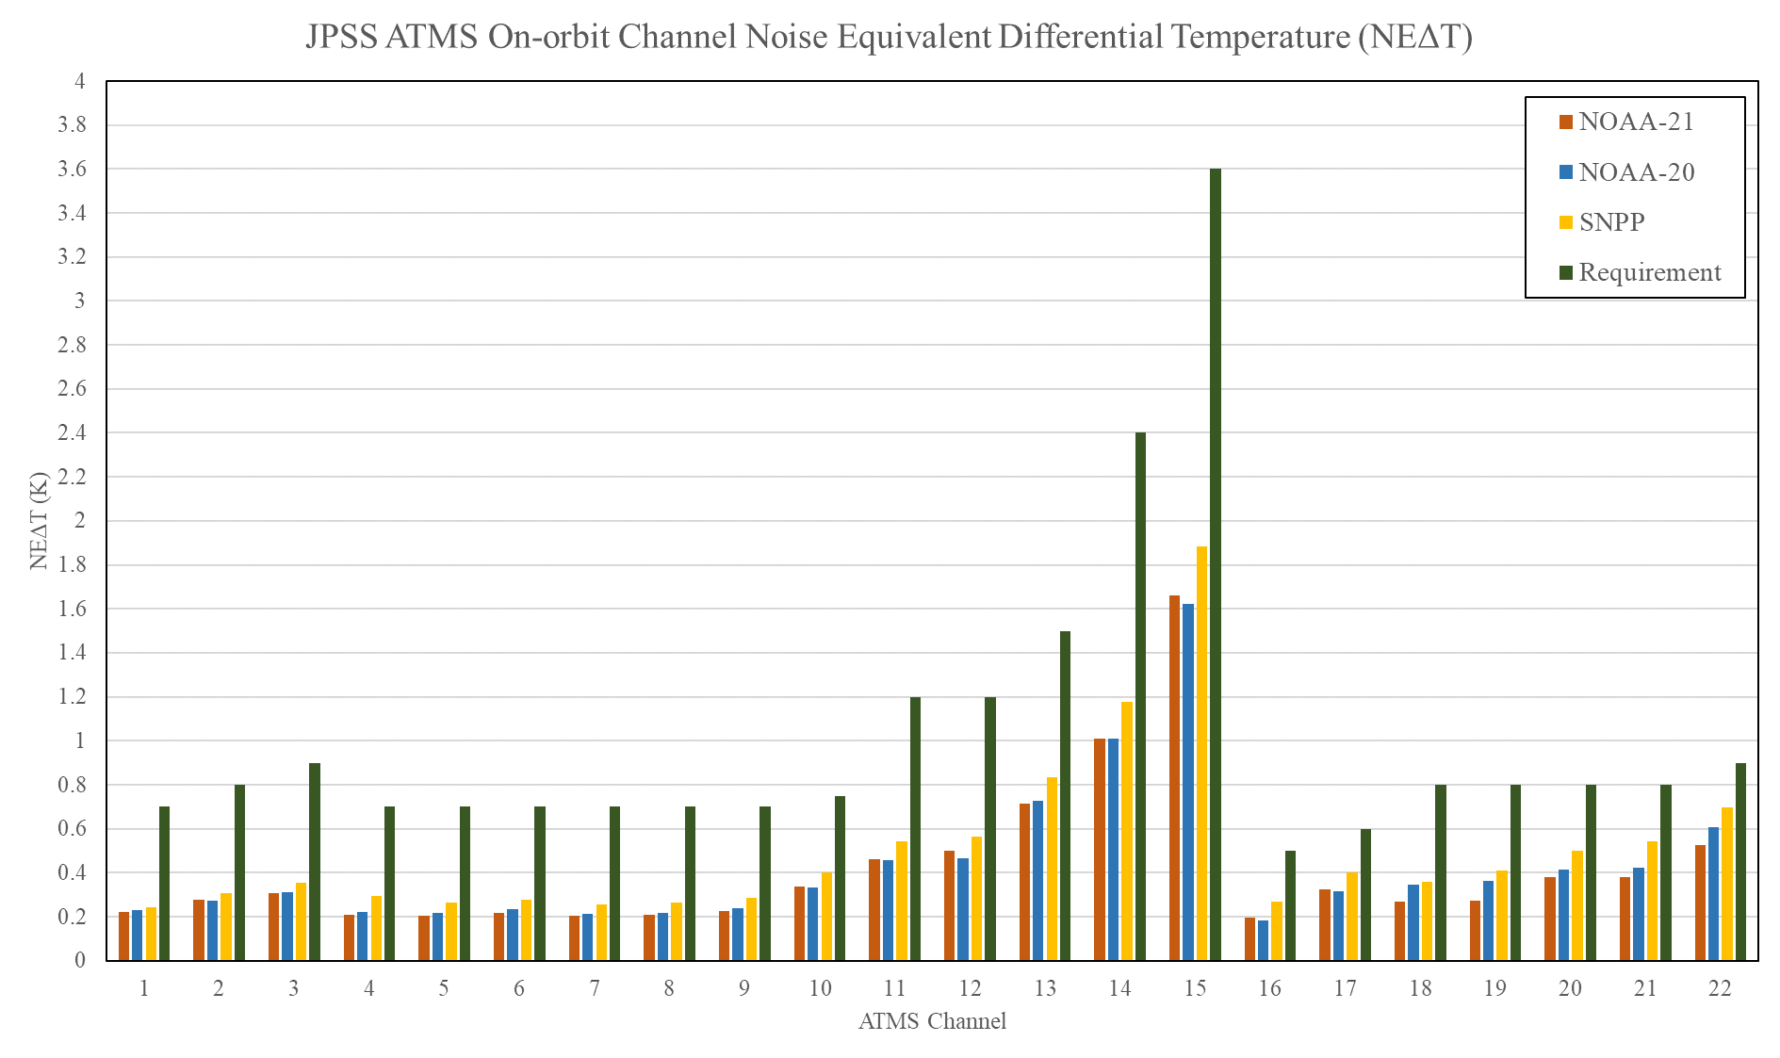
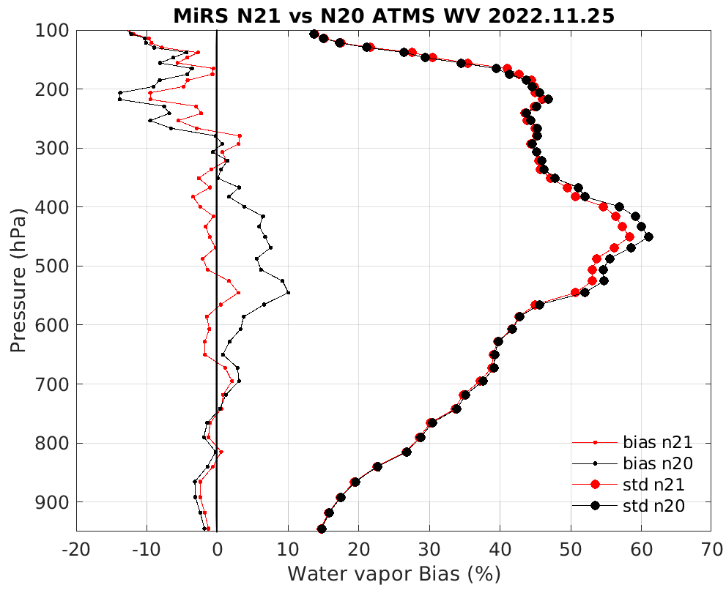
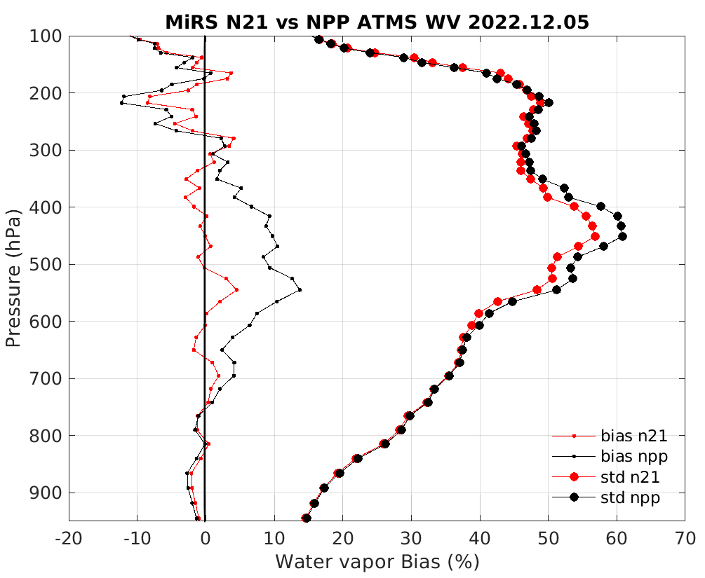
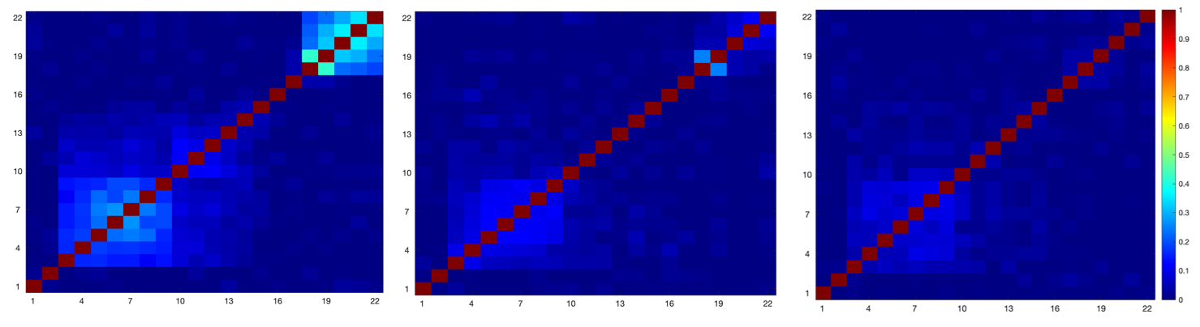
NOAA-21 ATMS SDR Provisional Maturity Highlights
(slide from N21 ATMS SDR Provisional Maturity Review presented by Mark Liu and ATMS Team)
ATMS limb-corrected and AI resolution enhanced, ch. 18
On orbit ATMS channel NEΔT
On orbit ATMS channel to channel noise correlation
S-NPP
NOAA-20
NOAA-21
MiRS vs ECMWF water vapor
N21 ATMS BUFR data have been available for public use since Dec. 15th, 2022

Slide 5
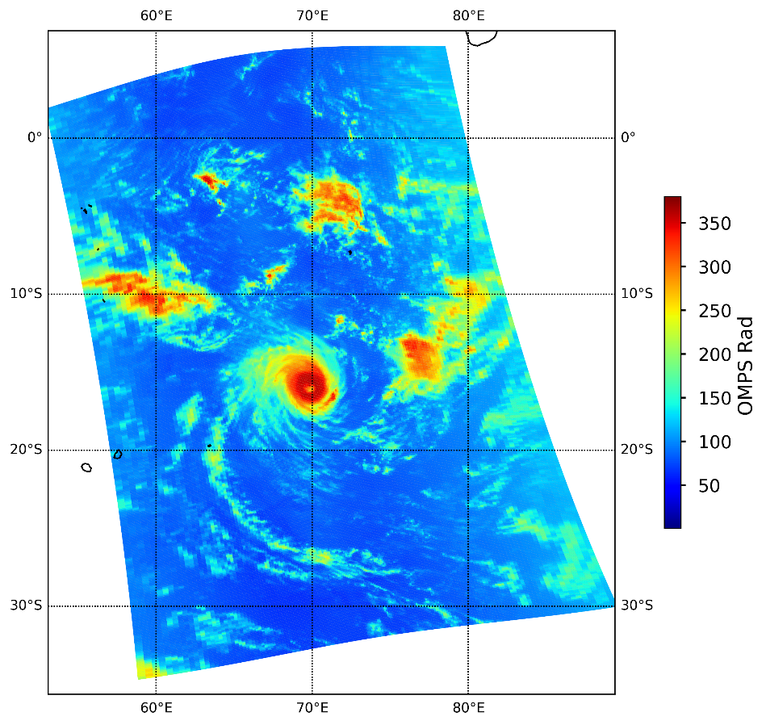
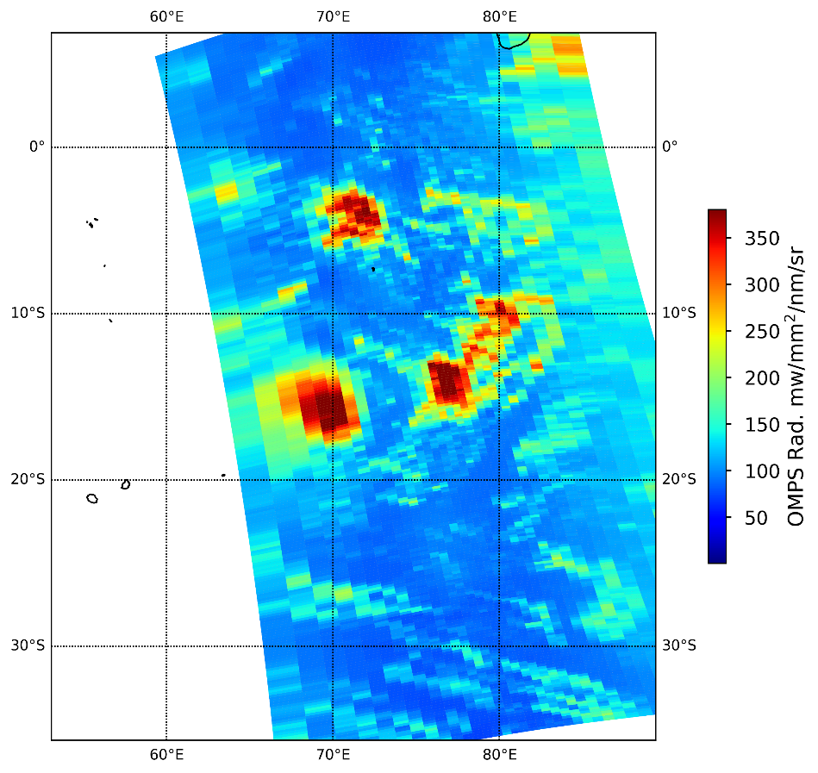
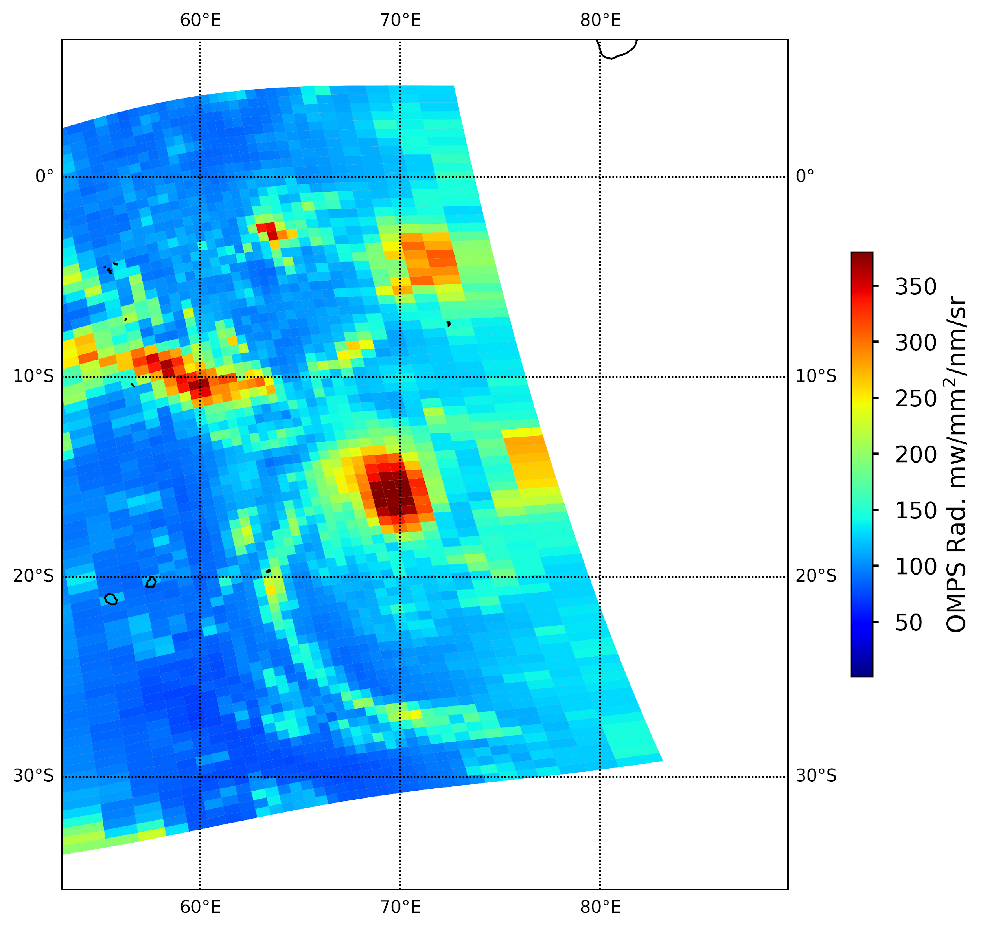
First Light Image on 02/18/2023: Tropical Storm in the Indian Ocean
(slide from N21 OMPS SDR Provisional Maturity Review presented by B. Yan and OMPS Team)
(a) NOAA-21
(b) NOAA-20
(c) SNPP
@Nadir: 12x10km²
@Nadir: 50x17km²
@Nadir: 50x50km²
NOAA21 OMPS NM captured fine structures of the cyclone including cyclone eye (70°E, 16°S) in the center
v
v
Radiance (mW\m²\nm\sr)
Both SNPP and NOAA-20 OMPS NM only observed coarse structure
Plots by L. Wang (CISESS)

Slide 6
NOAA-21 Science Product Validation &
Readiness for Operations (Mission Unique Products)
ATMS Level 1 Products | Beta | Provisional | Declares Ready for Operations | Validated
Temperature Data Record (TDR)* | Nov-30-2022 | Dec-03-2022 | Dec-15-2022 | Jun-22-2023
Sensor Data Record (SDR) | Nov-30-2022 | Dec-03-2022 | Dec-15-2022 | Jun-22-2023
CrIS Level 1 Product
SDR* | Feb-23-2023 | Mar-23-2023 | Mar-30-2023 | Sep-28-2023
VIIRS Level 1 Product
VIIRS SDR | Feb-23-2022 | Mar-30-2023 | Mar-30-2023 | Jul-13-2023
OMPS Level 1 Product
Total Column and Nadir Profile SDRs | Feb-23-2023 | Apr-13-2023 | Apr-19-2023 | Dec-22-2023
VIIRS Level 2 Products(s)
VIIRS Imagery* | Feb-23-2023 | Mar-30-2023 | Mar-30-2023 | Jul-13-2023
Validation Maturity Levels | Not Validated | Beta Maturity | Provisional Maturity | Validated Maturity
Ready for Operations | Declares Ready for Operations
*Key Performance Parameter (KPP)
Product quality documentation available: https://www.star.nesdis.noaa.gov/jpss/AlgorithmMaturity.php
Updated: Lihang Zhou, 05/12/2023
Notes:
5/12: ATMS Validated - moved from May to Jun 2023; due to the N21 updated ATMS SDR LUT for validated maturity was just implemented on May 12.

Slide 7
NOAA-21 Science Product Validation &
Readiness for Operations (Enterprise Products)
VIIRS Level 2 Products | Beta | Provisional | Declares Ready for Operations | Validated
Cloud Mask Cloud Property | Jun -2023 Sep-2023 | Oct-2023 | Dec. 2023 | Mar-2024
Aerosol Optical Depth and Particle Size Parameter | Jun-2023 | Nov-2023 | Jan-2024 | Jun-2024
Aerosol Detection | Aug-2023 | Dec-2023 | Feb-2024 | Jun-2024
Volcanic Ash | Sep-2023 | Oct-2023 | Dec. 2023 | Mar-2024
Ice Surface Temperature | Jul-2023 | Oct-2023 | Dec. 2023 | Feb-2024
Sea Ice Concentration and Ice Thickness | Jul-2023 | Oct-2023 | Dec. 2023 | Feb-2024
Snow Cover (Binary Map & Snow Cover Fraction) | Jul-2023 | Oct-2023 Jan-2024 | Dec. 2023 Mar-2024 | Jul-2024
Active Fire | Jul-2023 | Oct-2023 | Dec. 2023 | Jul-2024
Land Surface Temperature | Jul-2023 | Jan-2024 | Mar-2024 | Jan-2025
Land Surface Albedo | Jul-2023 | Jan-2024 | Mar-2024 | Jul-2024
GST (Global Gridded Surface Type)* | May-2024 | Jul-2024 | -- | Sep-2024
Land Surface Reflectance | Jul-2023 | Jan-2024 | Mar-2024 | Jan-2025
VIIRS Level 2 Products | Beta | Provisional | Declares Ready for Operations | Validated
Green Vegetation Fraction | Jul-2023 | Jan-2024 | Mar-2024 | Jan-2025
Vegetation Index (VI) | Jul-2023 | Jan-2024 | Mar-2024 | Jan-2025
Vegetation Health (VH) | Sep-2023 | Mar-2024 | Jun-2024 | Apr-2025
Ocean Color | Nov-2023 | Mar-2024 | Jun-2024 | Jul-2025
Sea Surface Temperature | May-2023 | Aug-2023 | Oct-2023 | Aug-2024
VIIRS Polar Winds | Nov-2023 | Jan-2024 | Mar-2024 | Mar-2024
VIIRS Flood Mapping | Jul-2023 | Jan-2024 | Mar-2024 | Jan-2025
CRIS/ATMS Level 2 Products
NUCAPS: AVTP, AVMP, OLR | Jun-2023 | Dec-2023 | Feb-2024 | Mar-2024
NUCAPS: Ozone, Trace Gas (CO, CO2, CH4) | Jun-2023 | Mar-2024 | May-2024 | Jun-2024
ATMS Level 2 Products
MiRS Products | May-2023 | Jun-2023 | Jun-2023 | Oct-2024
SnowFall Rate (SFR) | May-2023 | Feb-2024 | Apr-2024 | May-2025
OMPS Level 2 Products
Ozone EDR: NP | Apr-2023 | Jun-2023 | Sep-2023 | Jan-2024
Ozone EDR: TC | Apr-2023 | Jun-2023 | Sep-2023 | Jan-2024
Ozone LP (SDR&EDR) | Jun-2023 | Jan-2024 | Mar-2024 | Sep-2024
Validation Maturity Levels | Not Validated | Beta Maturity | Provisional Maturity | Validated Maturity
Ready for Operations | Declares Ready for Operations
*Global Surface Type is an annual product produced offline at STAR
Updated: Lihang Zhou, 05/12/2023
Notes:
5/12: 1. OMPS NP ops from Jul to Sep 2023 due to table delivery delayed. 2. MIRS Provisional: moved from Oct to Jun 2023, since the team is expect to do it ahead of time.

Slide 8
Summary
Successful NOAA-21 post launch Cal/Val so far - as summarized from the JPSS-2 NOAA Handover Readiness Review (March 29-30, 2023):
  Data products maturation progressing well
  NOAA-21 Product generation is performed in NCCF
    First of JPSS satellites to fully use NCCF
  J2 ATMS and OMPS are performing as expected and have better performance than NPP and JPSS-1
Incorporated the NOAA-21 Cal Val schedule with the NDE Migration to NESDIS Common Cloud Framework (NCCF) schedule - expect to complete the migration in 2024
IDPS Mx8 TTO is now scheduled to be in early July. Mx8 ADL is going to be posted on FTS for the HRD users as soon as its available
JPSS Data is now available on NOAA Open Data Dissemination (NODD):
https://noaa-nesdis-snpp-pds.s3.amazonaws.com/index.html
https://noaa-nesdis-n20-pds.s3.amazonaws.com/index.html
https://noaa-nesdis-n21-pds.s3.amazonaws.com/index.html

Slide 9
Backup - Upcoming NOAA-21 Maturity Reviews
May, 2023 Maturity Reviews (June 1st, 2023)
Active Fires (NDE), eFire | Beta | 6/1 (live presentation via Google Meets)
OMPS Ozone (V8TOz & V8TOs) | Provisional | 6/1 (live presentation via Google Meets)
NUCAPS EDRs | Beta | 6/1 (live presentation via Google Meets)
June, 2023 Maturity Reviews (June 22nd, 2023)
ATMS SDR/TDR | Validated | 6/22
MiRS EDRs | Provisional | 6/22
OMPS Ozone (V8Pro) EDR | Provisional | 6/22
OMPS LP (SDR & EDR) | Beta | 6/22
Cloud Mask EDR | Beta | 6/22
AOD/ADP EDRs | Beta | 6/22
Questions: Lihang.Zhou@NOAA.GOV THANK YOU VERY MUCH!!

